Slide 1
Small adjustments
Add sponsors iFlux, Biotage to sponsor page with logo
Registration date of conference should be adjusted

Slide 2
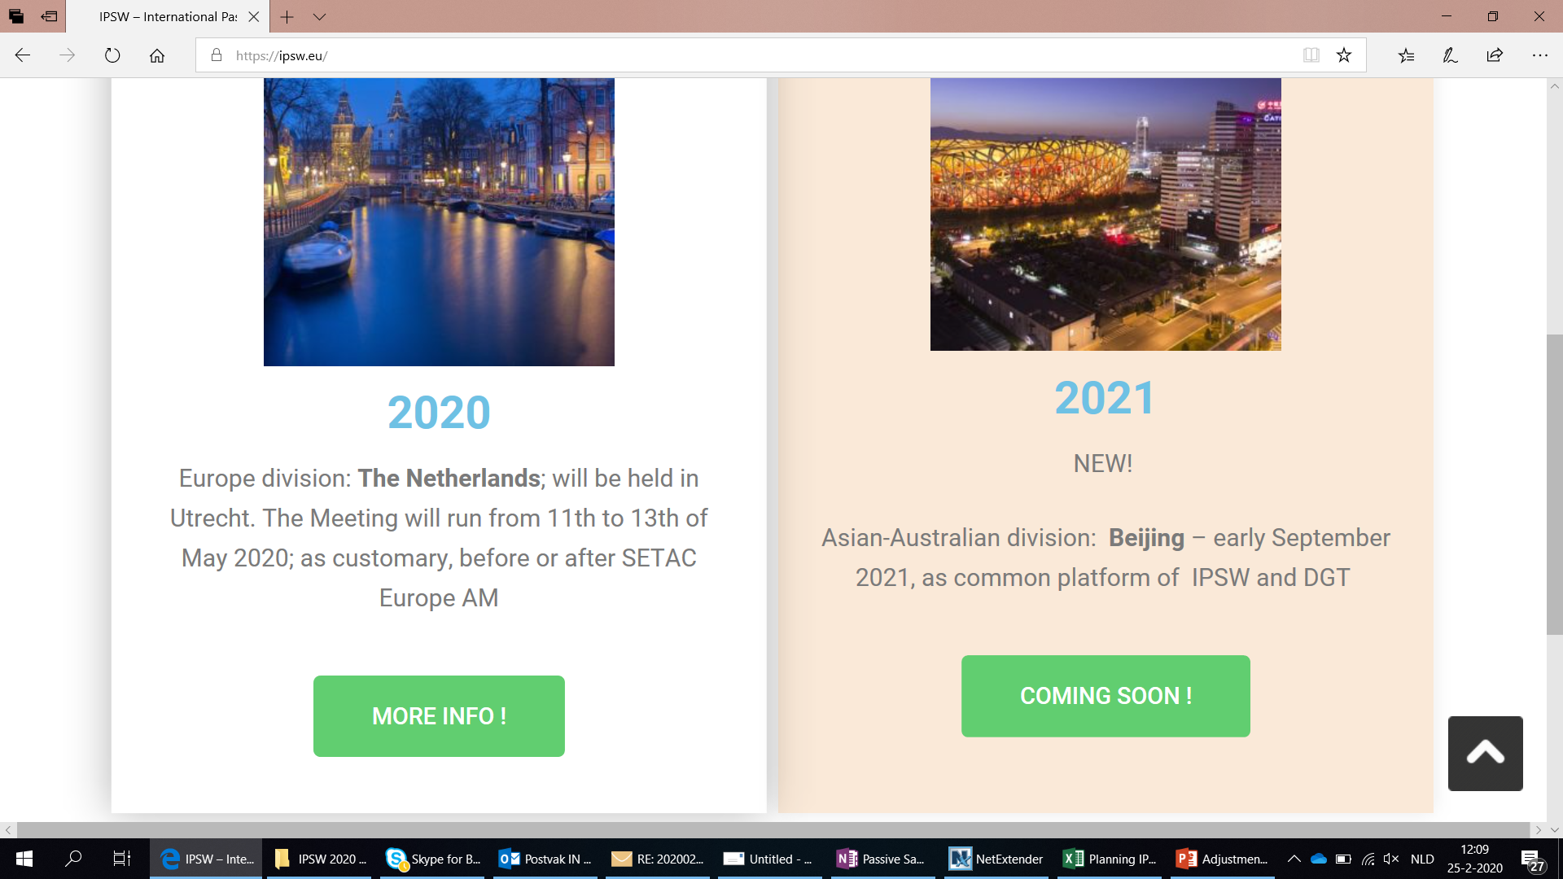


Slide 3
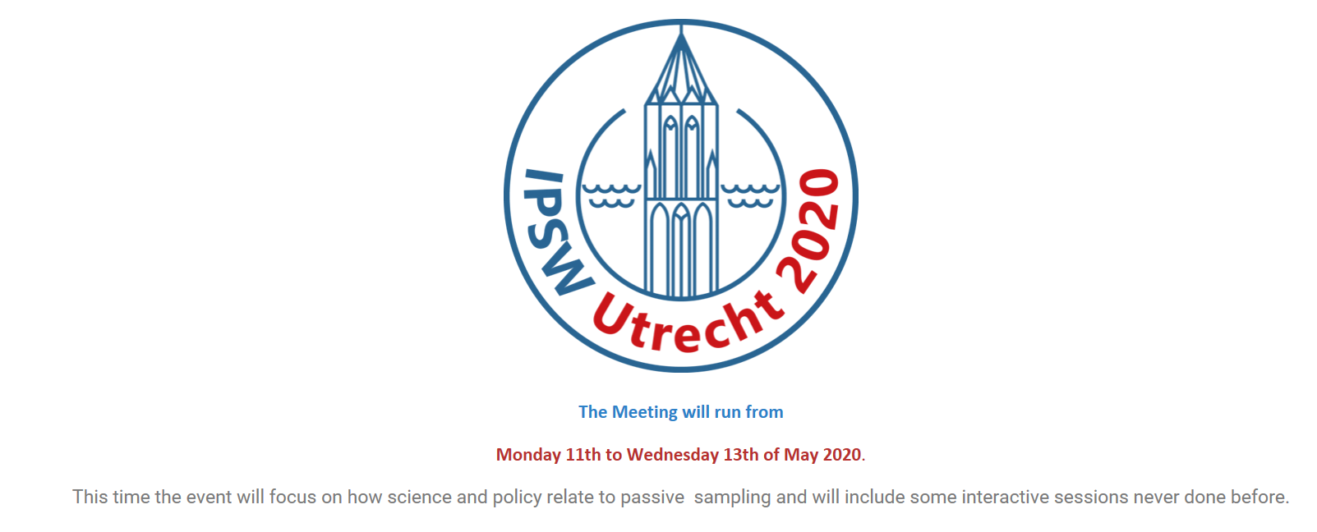
All grey text please adjust to larger font size and black

Slide 4
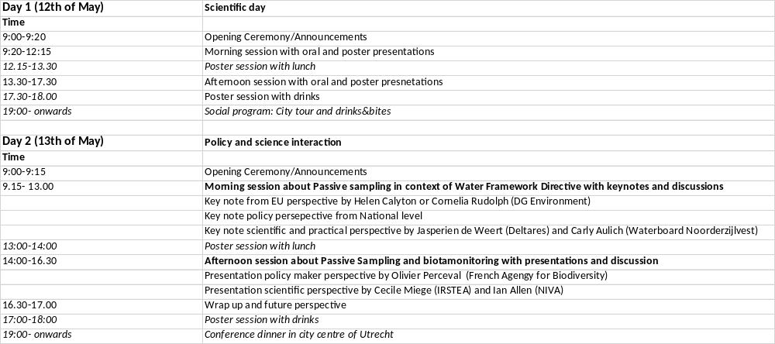
Preliminary program
Please adjust the table in a good lay-out

